Slide 1
Sales Revenue Based on Different Products
Eswar Aditya
PGA 30

Slide 2
Agenda
Introduction
Data Preview
Exploratory Data Analysis
Conclusion

Slide 3
Introduction
The Data tells about the quarterly Sales Revenue of 2022 and it allows to track sales performance for different products to the client countries.
Tracking sales revenue on a quarterly basis offers businesses a structured framework for monitoring performance, planning finances, adapting strategies, and communicating with stakeholders, ultimately contributing to long-term success and sustainability.

Slide 4
Data Preview
Dataset has the following columns.
Product: Name or code of the product.
Client: Name of the client or customer purchasing the product.
Client Category: Classification of the client (Gold, Platinum, Silver, Bronze, low Priority).
Product Country: Country where the product is sold or manufactured.
(Australia, China, Hong Kong, India, UK, USA, Korea)
Qtr 1, Qtr 2, Qtr 3, Qtr 4: Sales or revenue figures for each quarter of the year.
Total Sales: Cumulative sales or revenue for the entire year.

Slide 5
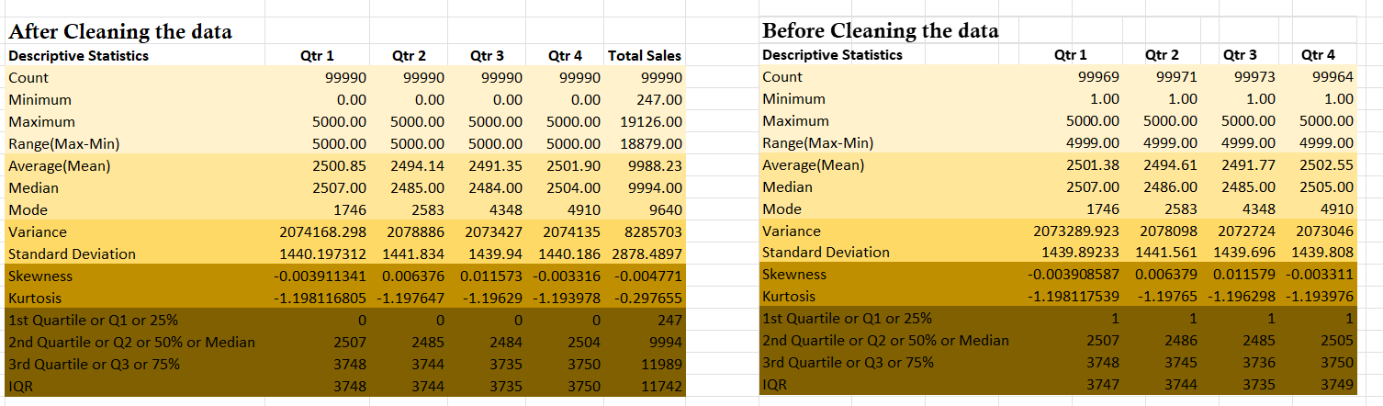
Exploratory Data Analysis
From here we can see that we have some missing values so we impute them for better analysis.
We created a column as “Total Sales” to find the overall sales of the clients.
The above Picture Tells about the Summary of the numerical columns.

Slide 6
Most Sold product
Total Sales in a Year of 2022.
By the information in the tables, it is evident that Product 25 has the highest sales revenue when compared with other products.
However, it is the total sales of all the products are relatively comparable.
Products | Sum of Total sales | Rank
Product25 | 145822767 | 1
Product2 | 143939976 | 2
Product18 | 142850538 | 3
Product7 | 142288873 | 4
Product19 | 141871745 | 5
Product12 | 141711345 | 6
Product4 | 140238256 | 7

Slide 7
Total Sales in Quarterly
This chart provides the information of product wise information of products performance in different quarters.
As in the tables, we can understand that from all the tables Products 25 & Product 2 are best performing in all the quarters.

Slide 8
Country wise product sales
This chart tells about the country wise total sales according to product categories.
From chart we see that product25 in “Hong Kong” having highest sales compared to others.
The least product sold is product7 in “Australia”.
Also we see that error bars tells about the uncertainty of the data.

Slide 9
Quarter Sales Based on Country
This chart shares the information about which country generates the best sales quarterly.
From the chart we can say that most of clients ordering from Korea.

Slide 10
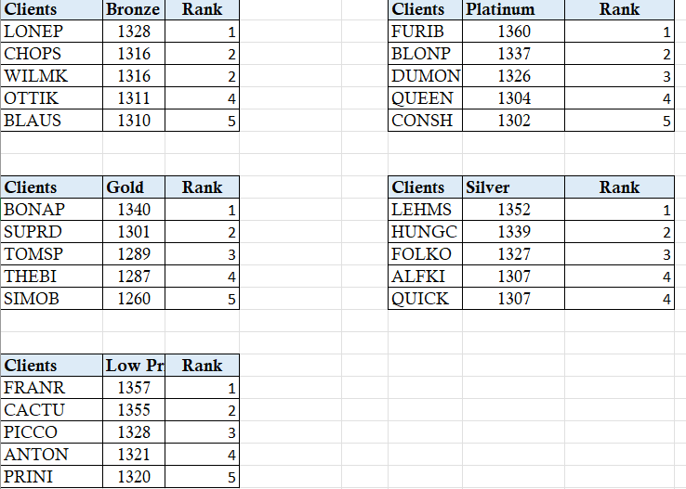
Top clients Based on orders
This tables provides the information about the top performing clients based on different products sales revenue.
Those are the top 5 clients of each client category orders.

Slide 11
Conclusion
Based on the provided sales data for various products across different clients, several conclusions can be drawn:
Top Performing Products: Products such as Product25, Product2, and Product18 consistently generated high sales figures across multiple clients, securing top ranks in total sales. These products likely hold significant market demand or offer compelling value propositions.
Client Engagement: Certain clients consistently appear among the top ranks across multiple products, indicating strong engagement and purchasing behaviour. Understanding the preferences and needs of these clients can help tailor marketing strategies and product offerings to maximize sales opportunities.
Market Dynamics: Variations in sales rankings across different products and clients reflect the diverse nature of the market. Factors such as product popularity, client demographics, and competitive landscape influence sales performance. Analysing these dynamics can inform strategic decision-making and resource allocation.
Opportunities for Growth: Identifying clients with lower sales rankings presents opportunities for targeted marketing efforts or personalized engagement to increase sales volume. Additionally, exploring product-specific trends and customer feedback can uncover areas for product enhancement or innovation to drive future growth.
Strategic Partnerships: Collaborating with top-performing clients or leveraging insights from their purchasing patterns can strengthen partnerships and foster mutually beneficial relationships. By aligning business objectives and catering to client needs, companies can enhance market competitiveness and drive sustainable growth.
In conclusion, analysing sales data at the product-client level offers valuable insights into market dynamics, client behaviour, and growth opportunities. Leveraging these insights strategically can optimize sales performance, enhance client relationships, and position businesses for long-term success in a dynamic marketplace.

Slide 12
Thank You.

